Slide 1
Celebrating 150 years of Broadwater
These are a selection of memories that have been shared with us about the school.

Slide 2
Margaret Peacock
I attended this school around 1965. The Head Teacher was Mr Tammage. My class teachers were Miss Toone and Mr Hansford. Mr Hansford was very scary! He told terrible stories of warning that if we did certain things the consequences were dire! He used to test our tables.
I remember boxes of small, wooden puzzles in pink or blue boxes. These were usually for rainy playtimes. I also remember a classroom in a shed/barn in the playground where we learned Colour Factor with wooden, measured blocks.
I also remember my mum picking me up for lunch, we lived in Broomfield Avenue.
The cloakroom had caged lockers and the toilets were outside without rooves. It was always so cold out there we tried not to go!
My maiden name was Margaret Tickner.
I remember the singing time with the radio programme. I remember being taught to dance The Dashing White Sergeant and I remember basket weaving over several weeks in the hall.
The corridor past the Head's Office was polished wood that creaked so you tiptoed through.
I recall a rounders match where we had to throw the bat down before we ran. I threw it down and it bounced up into Katie Phipps face and split her lip. She was my best friend and forgave me. To this day she still has a crooked lip!!
We had to drink our third of a pint milk through a straw and it was a great honour to be given a pencil to puncture the lids if we were chosen to be the milk monitor that day.
Most of all I remember it was a happy school.

Slide 3
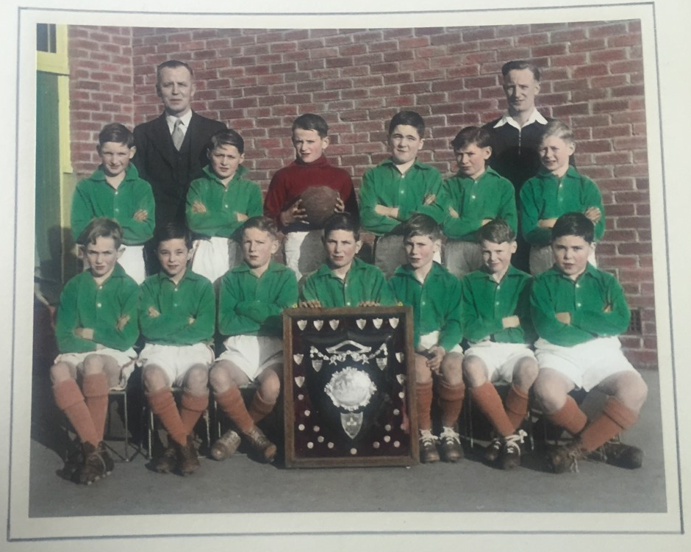
Andrew Davison and family

Slide 4
Andrew Davison and family

Slide 5
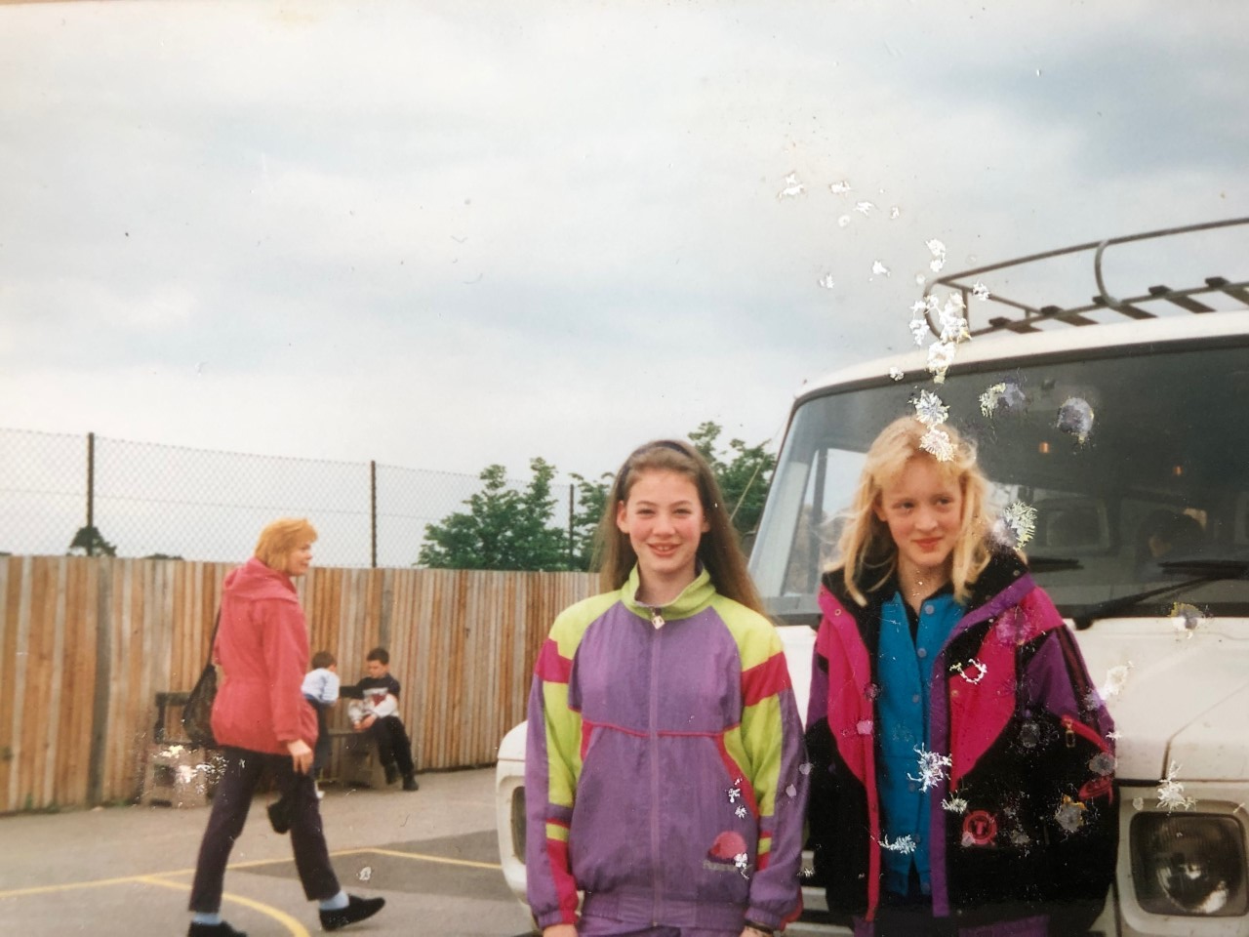
Andrew Davison and family

Slide 6
Elizabeth Holmes
I still have the leather bookmark that every child was given for the Queen's silver jubilee in 1977. I have treasured it all this time!

Slide 7
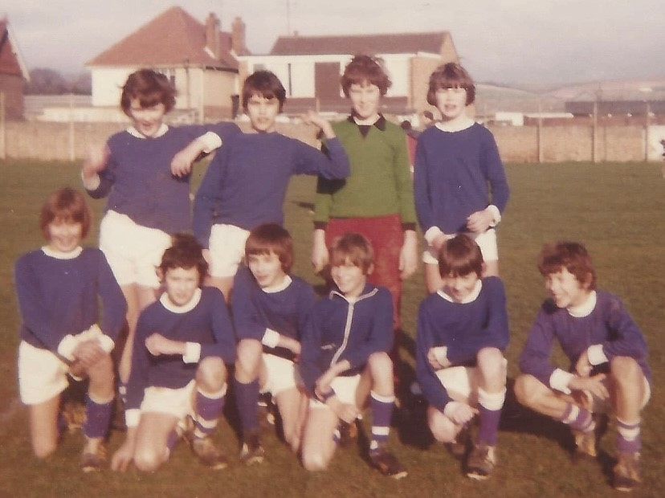
Ian Smith
Here is the football team from 1974
That’s me Ian Smith, bottom left.
Mr Green was our team coach.
This was after a match played against Lyndhurst.

Slide 8
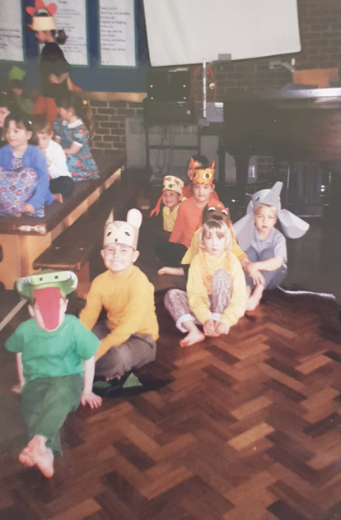
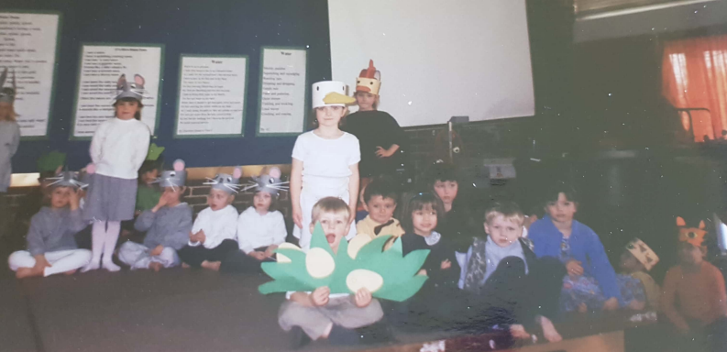
Lauren Rycroft
I've been through my albums from my time working here from 98-2006 and these are some that I thought you might like to see...
The children in animal masks was from a show reception did in March 1999. ( Pebbles and Shells)

Slide 9
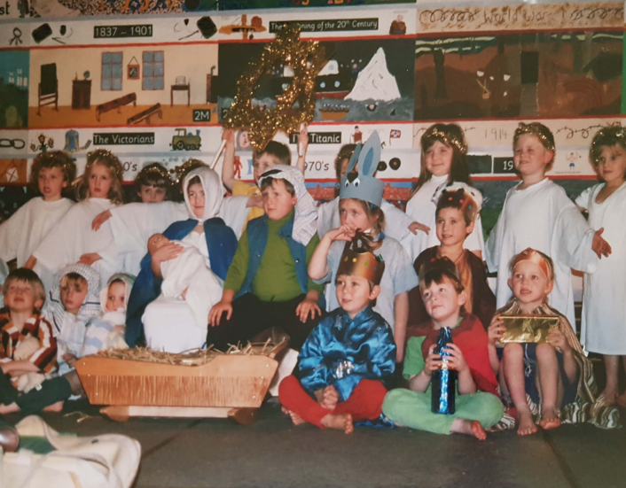
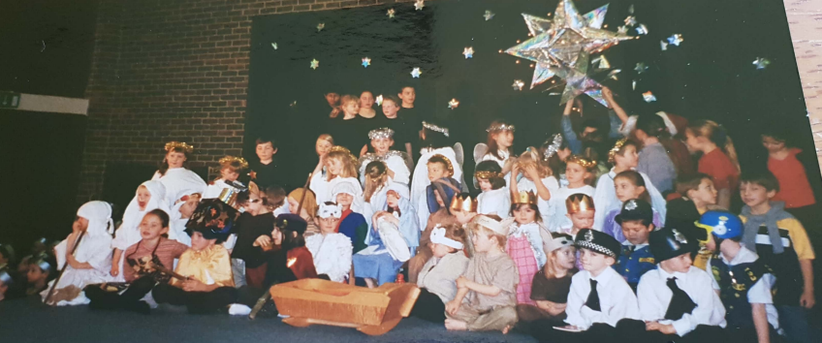
Lauren Rycroft
The nativity with the large tinsel star was reception 1999 and 2000.

Slide 10
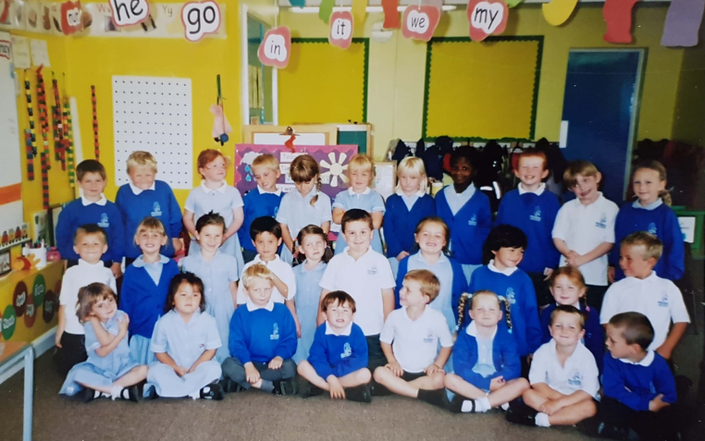
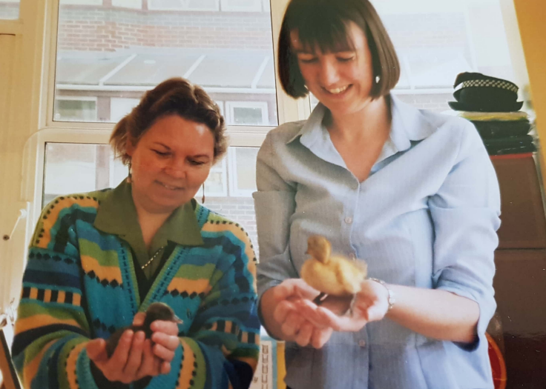
Lauren Rycroft
The class photo was Pebbles class 2002-2003.
Mrs Jo Tilley and Mrs Karyn Hinks holding ducklings in 2002. We were the best team and I loved my time working at Broadwater, especially with these guys!

Slide 11
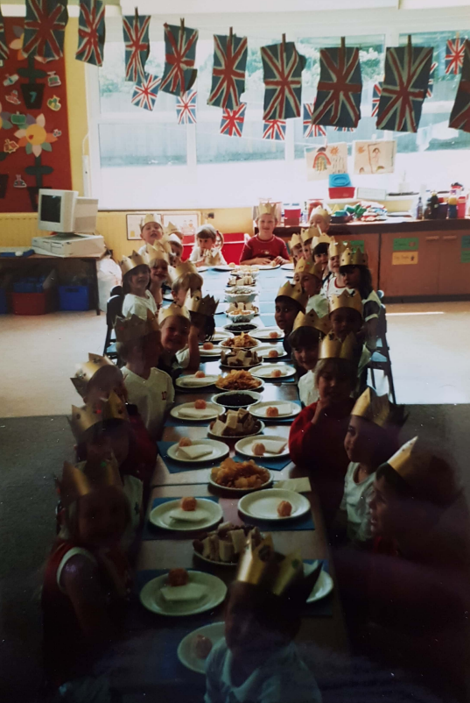
Lauren Rycroft
The party in the classroom with flags and crowns was for the Queen's Golden Jubilee May 2002.

Slide 12
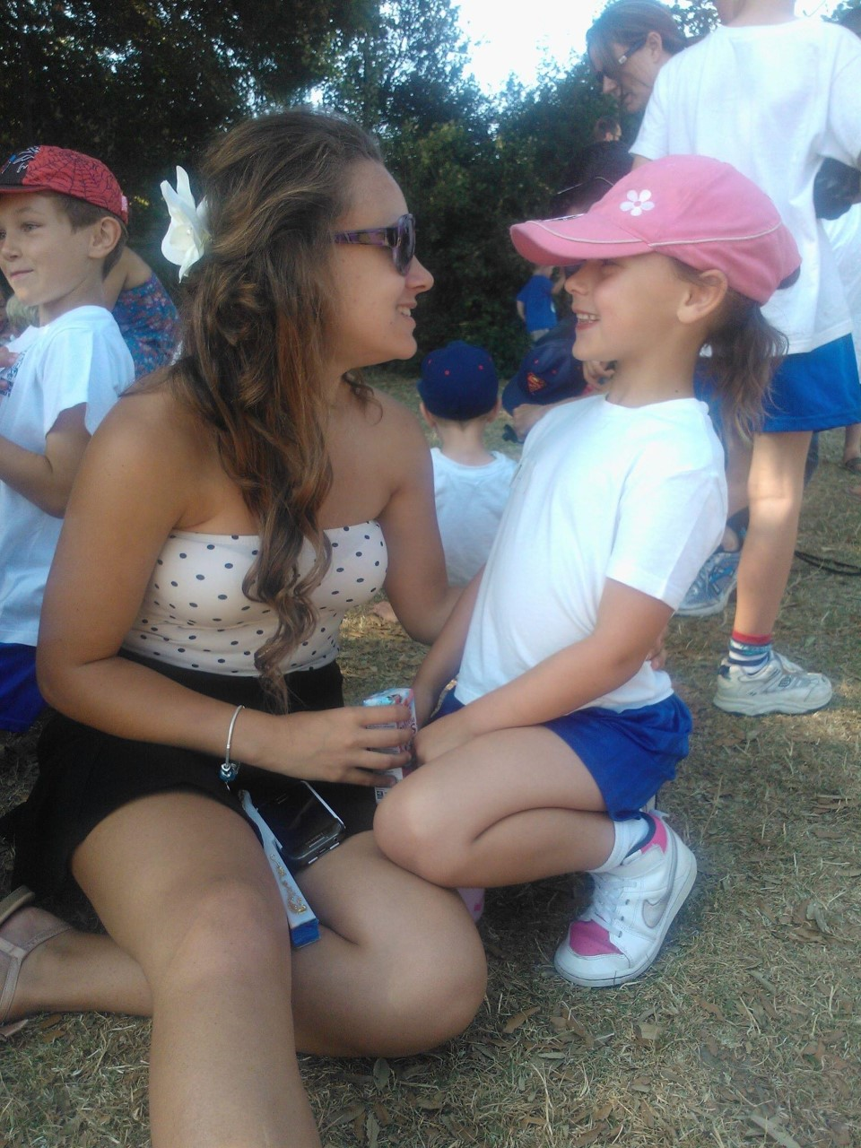
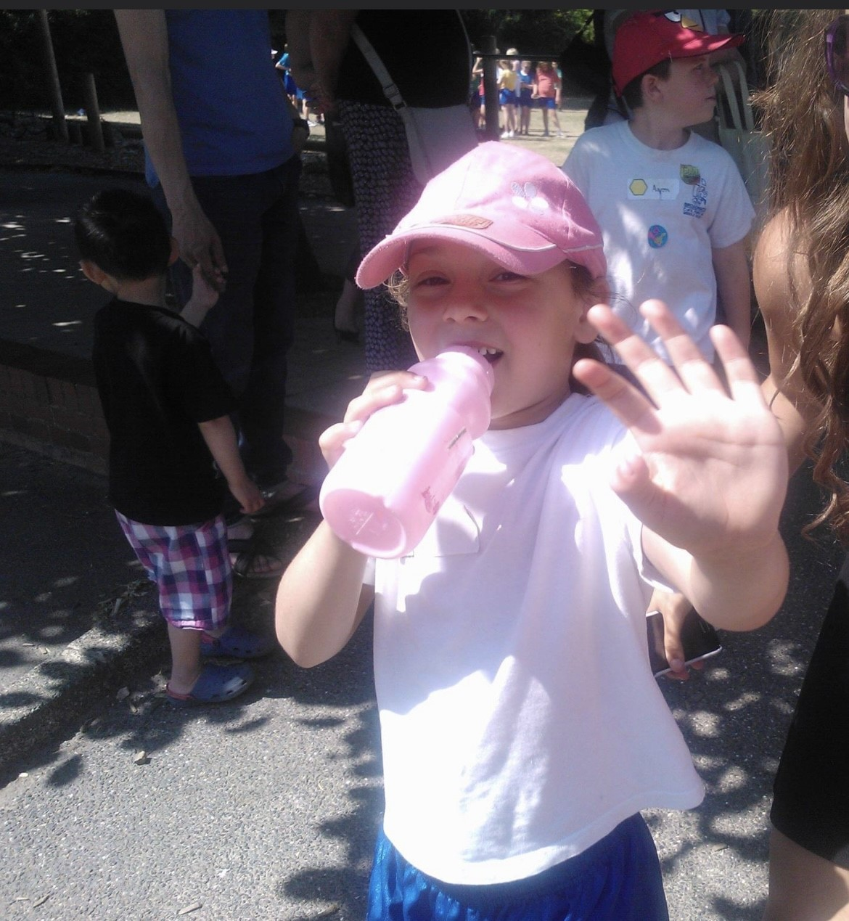
Emily Matthews
I’ve found some photos of my sister (Lily Moss) when she was in reception in 2013 on her first sports day.

Slide 13
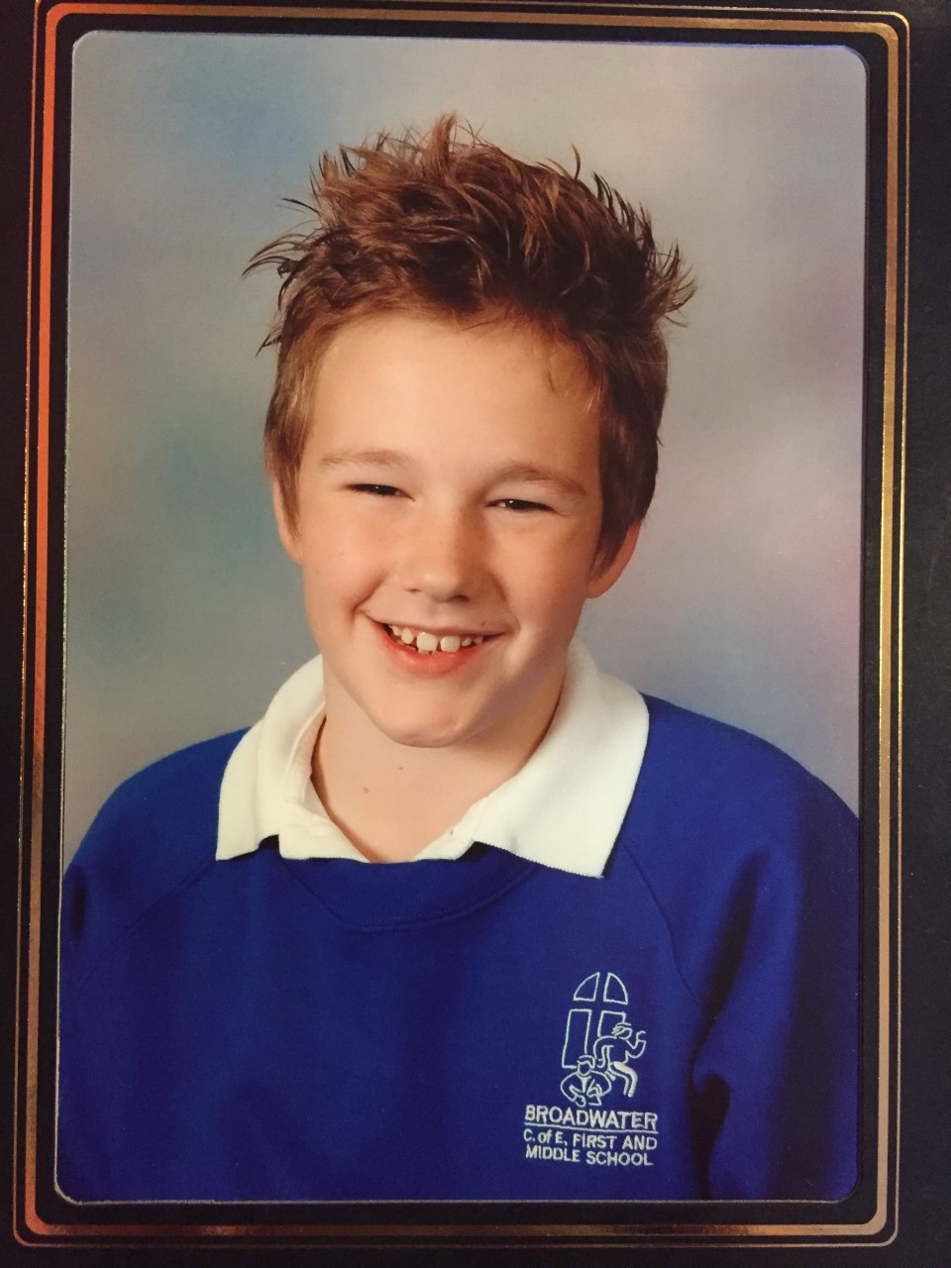
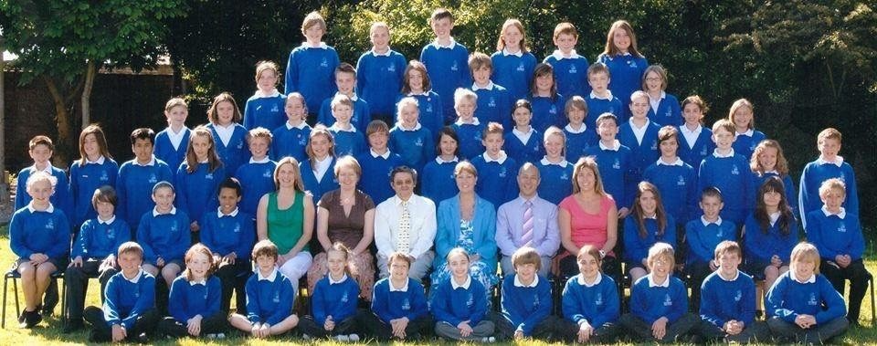
Jordan Bailey
Hello, I attended broadwater c of e along with my sister when Jo Sharp was headteacher and Jez Wong as deputy head for the last couple years and from my memory was certainly sharp. I have fond memories of some of my teachers and teaching assistants especially of my favourite teacher of all time Miss Kavanagh, Miss Kinshott-Acklan being my two most memorable.
I remember my father having a good relationship with miss Sharp as they were in church together, there was assembly’s my dad came in and did some puppetry and sung some of the songs he wrote, reading them off the overhead projector. I also remember in year 7 we did a show of Olivia and I was the judge.

Slide 14
Shaun Howard
I started at Broadwater in 1977 and what a school it was, I will start from day 1 and I turned up not knowing what to expect but my 1st teacher was Mrs Hennings who was lovely although on day one at that tender age I got told off for swearing and to this day Ive no idea where that came from or how I managed to blurt it out, Next class was with Mrs Elliott again a lovely lady but no memories of events there. Then it was onto Miss Toones class and I was dreading this as I always saw her as a very stern lady and I was petrified of her but it ended up she was brilliant with me and a really nice teacher.. Then it was of to I can't remember her names class but I do remember a french lady that covered her for one day and we didn't see eye to eye and she marched me into Miss Wheelers office and said "This boy has no brain" Cannot remember what I had done. Then it was off to Mr Houses class and I couldn't stand him and the feeling was mutual and he sent me to Mr Tammadges office (The Headmaster) to be put in the famous "BLACK BOOK" more times than I care to remember. Then I moved onto Miss James class and she was amazing and one of my favourite teachers ever as she was understanding and easy going and she liked me and understood my learning difficulties due to being deaf. Then it was onto Mr Marchants class for the final year and we didn't see eye to eye and the classic was in one lesson he asked me what 1x1x1 was and I answered 3. He said Howard try again and I replied 2, He then threw my pencil case out of the open window but years later I came up against him in a football match and skinned him alive so that was karma lol. Mr Stephenson was brilliant and I remember messing about and jumping over some partition not realizing he had a class going on that room and he stepped on my toe and said "BUSTER, get out of here" We went on a trip to the Isle of Wight in the last year as well and that was amazing and it ended at Robin Hill I think it was and we were told in no uncertain terms were we to go on the assault course there as it had been bad weather and it was just covered with mud, Enter Stuart Bower and myself that decided it just had to be done and ended up at the coach getting another rollocking and having to strip off to our pants to be allowed on the coach the girls loved that one) .. Ending the memories now and what fantastic ones they were the good and the bad and what a fantastic school and I will sign off with respect to all of the teachers there back in the day. S.W Tammadge (headmaster) Mrs Hennings, Mrs Elliott, Miss Toone, Mr House, Miss James, Mr Marchant, Miss Spencer, Mrs Wheeler, Mr Miller, and not forgetting the lunch play supervisors Mrs Dale and Mrs Weller.

Slide 15
Helen Strace
I was a pupil of the school from 1971 until 1979, I can remember the following teachers/staff:
Mr Tammage (head teacher)
Miss Ringrose
Mr House
Miss Winton
Mrs Cass ( welfare office, she was lovely)
Mrs Sargent (or Sergeant)
Plus others that I have forgotten their names!
I quite enjoyed my time at the school, it was not too big and felt welcoming. The reception classroom had a reading corner and a play house and some dressing up clothes and was filled with interesting bits, like the little wooden blocks that we used in maths, different colours for 1cm, 2cm etc. and play money, all the new metric system. Although we were also taught feet, inches, lb's and ounces, we had the best of both.
Weekly spelling tests and times tables to learn, we learnt the three R's before anything else. When I went up to high school I did not know what History and Geography lessons were, not that we didn't study them back then, they were just called lessons. I remember learning sewing and embroidery, cookery lessons and Italic calligraphy.
We had milk from little glass bottles with straws, ok in the winter but a bit yucky in the summer when they got hot. Lunchtimes in the dining hall, we were given a treat of chips once a term! We had foods like liver and onions, spam fritters and mashed potato served up with an ice cream scoop. You weren't allowed out to play until the dinner lady was satisfied you had eaten enough.

Slide 16
Helen Strace
When I was in Miss Ringrose's class I remember she used to take us for P.E lessons on Broadwater Green, if you forgot your P.E kit she made you wear clothes from the dressing up box! She also had a dunce's hat that she would make naughty children wear, she was firm but fair!
I remember doing a traffic survey in Ardsheal Road, doing anything outside of the school grounds was exciting. I also remember visiting the local elderly care home when it was a residents birthday and taking flowers and pictures that we had drawn.
At the end of one year I remember we put on a production of Joseph and his Technicolour Dreamcoat.
We used to get lined up once a term or every half term to have our hair combed through checking for lice, I never had them, nor did my brothers.
When I was a bit older I remember sneaking into the graveyard at lunchtimes, peering onto the broken tombs and scaring each other.
I can also remember writing about what my life would be like in the year 2000, from memory I said I would be married, a housewife and have two children. I did have two children but have never married or been a housewife! I would have loved for my children to have attended Broadwater C of E but did not live in the catchment area.
I look forward to hopefully seeing more in the press regarding the anniversary, it may bring back more happy memories.

Slide 17
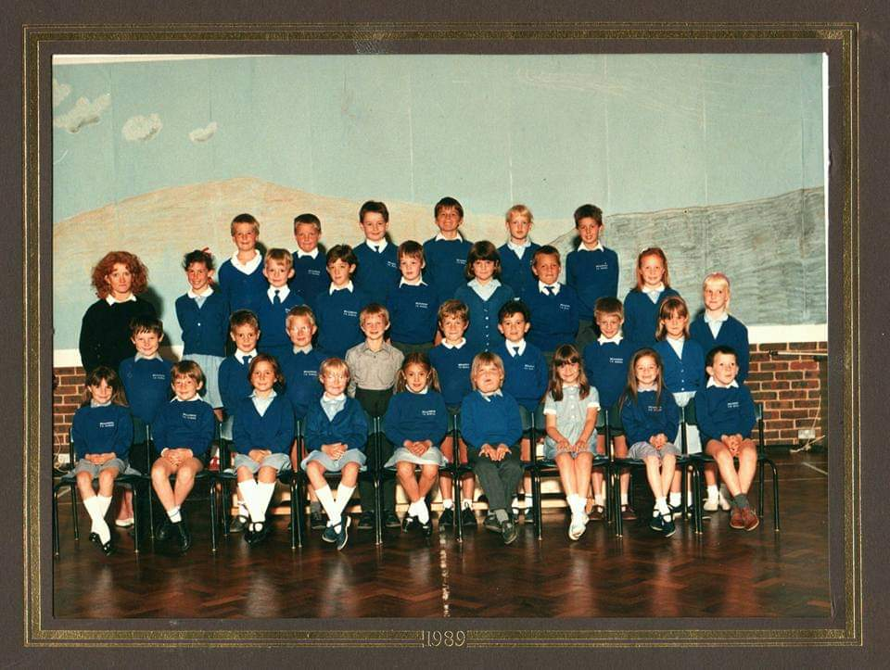
Emma Carter (Beacher)
I have so many fond memories of my time at Broadwater from the hustle and bustle of the Christmas fair to the fun at the end of summer term BBQ and disco, where families and teaching staff all got together and played games, danced and ate hot dogs in the play ground at the end of the year. It was such a community including all of the family not just the pupils. I've included photos from when I was in year 3 and my final year in year 7 which I think was 1993.

Slide 18
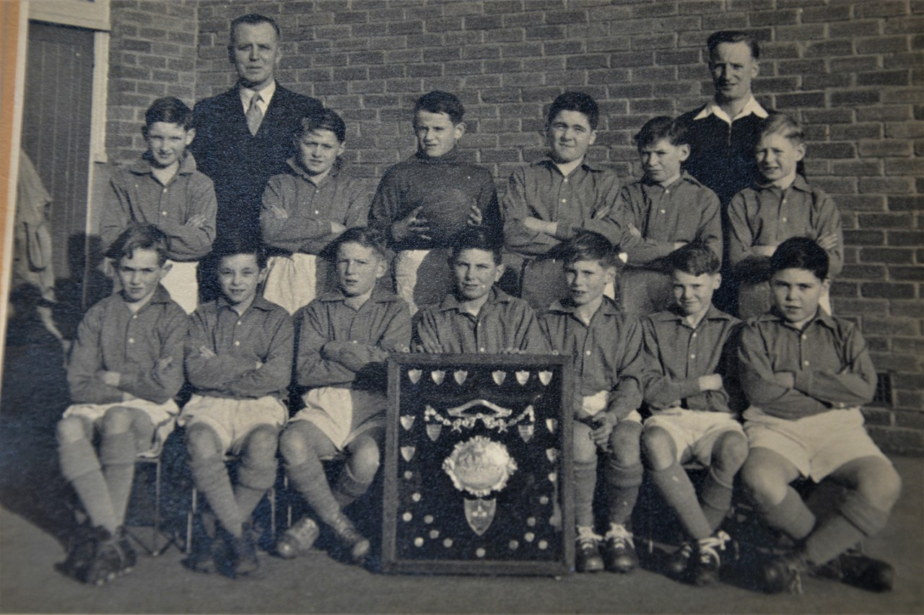
James Ayres
I attended the school between 1948 and 1953 when I left to go to Worthing High School. Our children also attended the school. Gareth 1980 – 1987 and Rebecca 1983 – 1990.
I was a member of the successful football team which won the Worthing and District Primary Schools Shield in 1952-53 season. The headmaster at the time was S A Fisher and the PE teacher Bernard Groom. Both are shown in the photo I have attached. I was amazed to find on visiting the school with our son in 1980 that the photo was still on the corridor wall at that time – probably still held in the school archives!
I can remember some of the names of the other boys in the team. John Cannons (captain) Trevor Payne Richard Hilder Dick Shephard Ian Mills.
I still have two old school reports from July 1950 and June 1952. Class teachers Mr Gibbins and Miss Bailey.

Slide 19
Andrew Crayford
My sister and I were a pupils at the school I think from 1967 to 1973, she actually was there a bit longer because she is younger than me. I remember taking part in the 100th Anniversary celebration. The Headmaster at the time was Mr Tammadge, I remember the names of some of the teachers, Miss Croudson, Mr Mounterfield, Miss Wilcox, Mrs Gibson-Poole, Miss Norrish, Mrs Davey, Miss Toone and then there was Mrs Cass who used to be who you went to if you got sick etc.
I have photos at home back in Australia(currently visiting mum and dad who still live in Broadwater) of us as a class sitting on the playing field next to the fire station having a tea party, I think with Mrs Gibson-Poole as our teacher. Obviously the photos won't get to you in time, I go back home down under on 3/5/23. I also remember drinking milk from small glass bottles during our break, that used to sit outside after they were delivered in all weathers, I bet that doesn't happen now?
I just saw the article in the paper and thought I would send you some of the memories I had if the school. I will add that I loved my time there it was a good school.
Thanks for the chance to relive some memories.

Slide 20
Claire and James Bamber
Broadwater holds a special place in our hearts and we continue to thank God for all our daughters, and all we received through it.

Slide 21
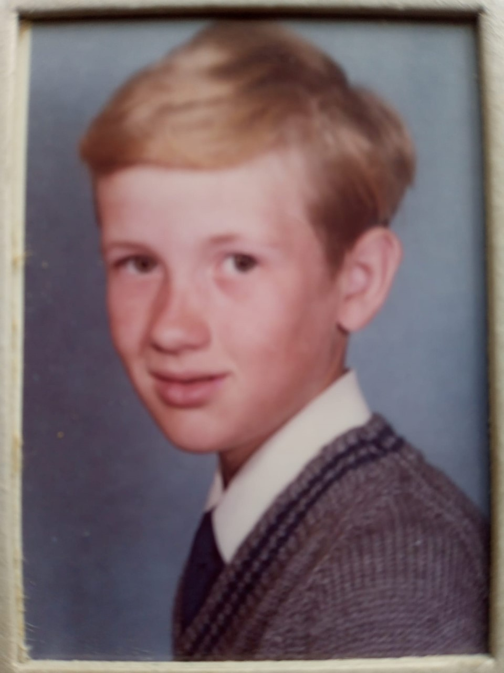
Zara Goldsmith- Rush
My father in law has sent me the attached documents about his time at Broadwater C of E School in the 60s.
In the class photo, Richard has told me that he is 8th from the left (the one looking down at the ground!).
He's very happy to know that his Granddaughter, Eliza Goldsmith-Rush, now attends the same school and is loving her time there just as much as he did!

Slide 22
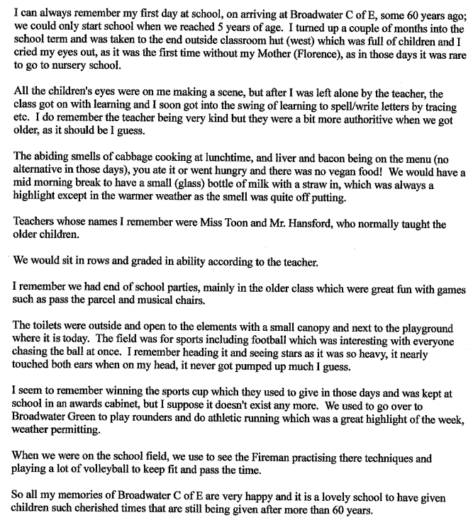
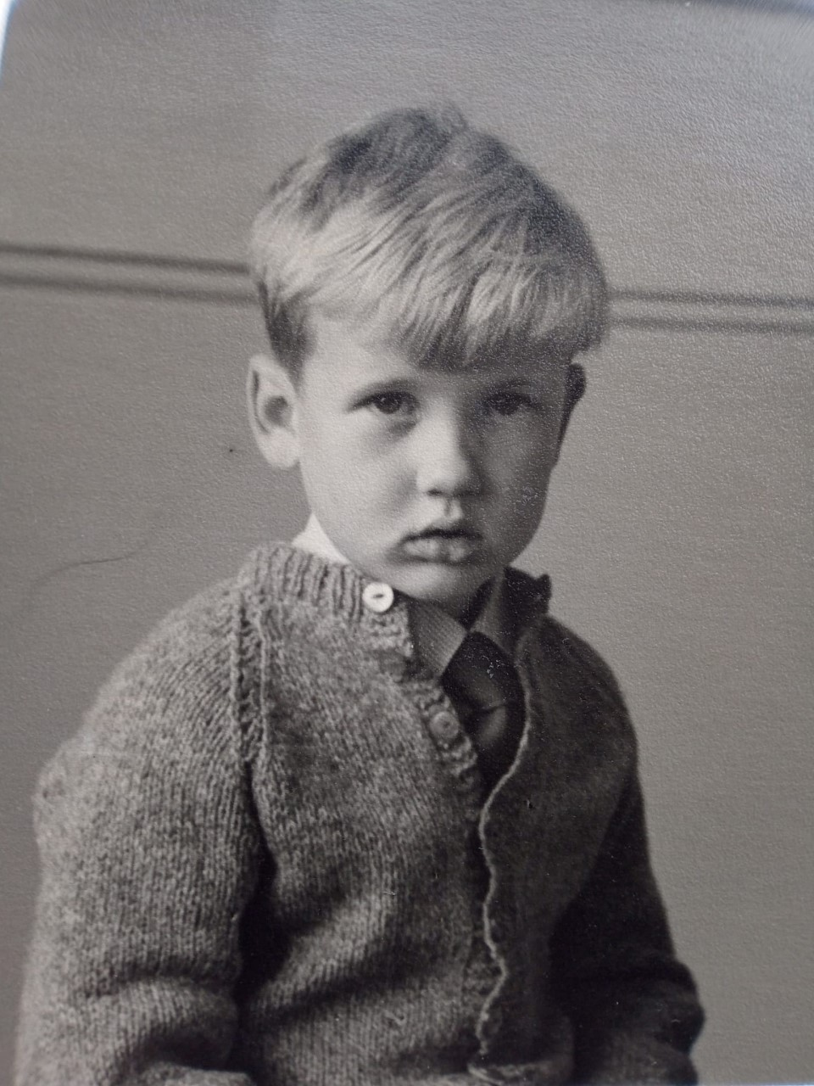
Richard Rush

Slide 23
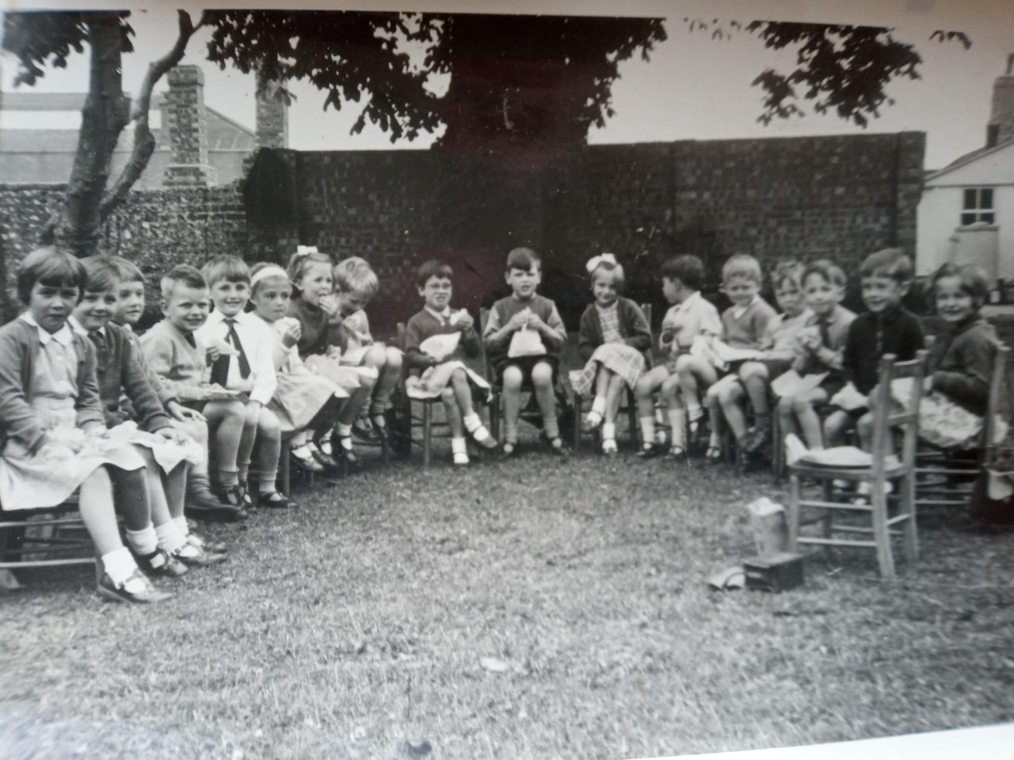
Richard Rush

Slide 24
Elizabeth Sparkes
I was a pupil at the school from 1972 to 1980.
I remember the celebrations for the 100th Anniversary of the school and my mother has a number of photographs of that day of me, aged 5, in Victorian dress for the occasion together with a number of others. I think these include the then Headmaster, Mr Tammadge, and Mrs Cass, the school’s matron. Would you be interested to see these for your collection?
I have been in London for a number of years but returned to Worthing about 15 years ago to raise my family. I am now an elected member of West Sussex County Council and the area I cover includes some of Broadwater including the Green!
My daughter is currently at University studying for a BA in Primary Teaching and came to your school for a few days of work experience a couple of years ago when she was at the Sixth Form College. I was so pleased she was able to come into the school and this has spurred her on into teaching!

Slide 25
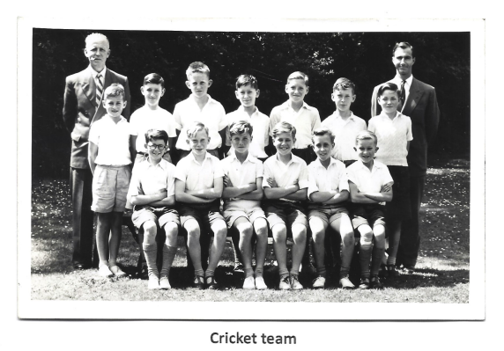
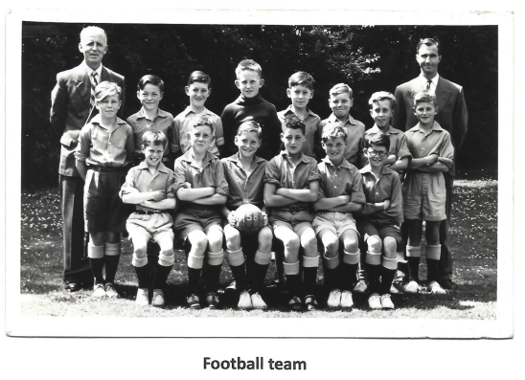
Peter Kent
As a pupil (with my sister) in the 1950’s I have fond memories, amongst others, of being a member of the school cricket and football team in 1958. In the football team photo - I am located second from the right standing in front of John Sams the sports master and second from the right sitting in the cricket team photo.
The headmaster to the left of the photo was Mr Fisher and John Sams went on to become the owner and head of Broadwater Manor School.

Slide 26
Miss Dorothy Wilcock
Dorothy taught at Broadwater CE Primary School and is now 94yrs of age.
I was an infants teacher at Broadwater Church School for many years. I joined the school in September 1954 I think when Mr Fisher was the Headmaster. I'm afraid I cannot find many photos but am pleased to send you two and a picture of the bookmark which I keep in my Bible.
There were only 5 classrooms in those days and the hall with doors opened on to the outside. There were some brick built air raid shelters adjoining the cemetery walls and a small room on the field wall where I finished my teaching career called the hut!
We acquired the use of the 'field' while I was there and the fire station was built adjoining the field. The fire station had a habit of having a practice of climbing their tall ladders when we had a sports day which was very distracting!

Slide 27
Miss Dorothy Wilcock
We had some 'characters' among the teaching staff - Miss Rudd who went on a school exchange to America and was never seen again! For one year we had an American teacher in her place who was delightful and sometimes I had to correct her American spelling from charts on the wall! Then there was Miss Bailey who ruled her class with a rod of iron which did marvels with the junior aged children.
I wonder if Joslyn Arnold has contacted you, she was a very young teacher then. She has since had her 2 grand daughters at Broadwater school, now at St. Stephens Church and you could contact her via Broadwater Church Centre.
I occasionally see some of my ex pupils who introduce themselves as I probably don't recognise them, probably now grandparents.
Then there was Mrs Cass (not a teacher) who was a great help in my infants class helping adding up dinner money and changing in to plimsolls, some with laces and looking after sick children until they were collected.
I only remember having one inspection, when the inspector came into my classroom and said he didn't know much about 5 and 6 yr olds, so that was the end of his visit!
There was no school uniform when I started there. No class room assistants but a few kind mothers who came to help out. I had Dorothy Holmes who had 3 children at the school and came in one afternoon a week to help with 'painting' which was a very 'messy business' as we had powder paint which was mixed with water in jam jars - a very messy job.

Slide 28
Linda Russell
I followed in my mum’s footsteps by attending Broadwater school along with my sister Jennifer Russell 1972- 1979
I have great memories of my time at the school under the leadership of headmaster Mr Tammage.
My first memories of starting school were in a long thin hut type classroom which sat along the edge of the playground and bordered the field. Quite old fashioned. My first teacher was Miss Wilcox I believe, followed by Miss Saxby, Miss Toone, Miss Crowdson, Miss Ringrose, Mrs Davie, Mr Green, and Miss Head [ Spencer]
I turned 5 in the February and started school in the Easter term 1970.My first day I wore the summer uniform which at the time was blue with white spots.
The school was still its original size when I joined, with the big hall being completed sometime whilst I was there.
The centenary was a big deal for us all. A big event was held on the school field where we all dressed up in clothes of the Victorian era, with musicians and dancing. The weather was kind to us.
We had some trips out, Weald and Downland Open air museum and Devils Dyke, but unfortunately our class holiday to France was cancelled, due I remember to some unruly boys in the class. I was so disappointed.
We produced a production of Toad of Toad Hall to mark our farewell to the school, in summer 1977. Great fun.
I have nothing but fond memories of my time at Broadwater and am still in touch with some of my old classmates. Several of us have a message group where we chat about old times. Not bad for over 50 years!

Slide 29
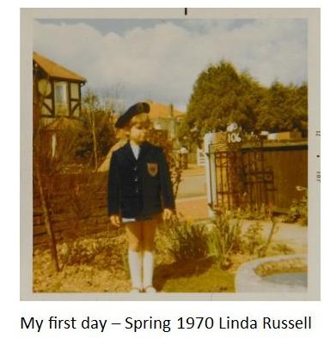
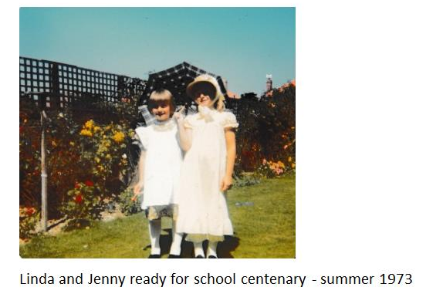
Linda Russell

Slide 30
Joyce Russel (Smith)
Pupil 1941-1947
Staff 1970’s - 2000
Joyce was a pupil at Broadwater school around 1941 to 1947. Her time at the school spanned over part of the second world war. Unfortunately, we don’t have any stories from Joyce relating to this era other than using the air raid shelter on the end of Broadwater green.
When her two daughters [Linda and Jennifer] also attended the school in the 1970’s Joyce returned to the school, as a school dinner cook and also later on as playground dinner lady.
She worked at the school for about 30 years, and only reduced her hours when sadly the school hot dinners ceased to be. She worked with a lovely team of ladies, great team spirt, and fun times were had. Any activities around the school that required a helping hand she would always be there.
When the school celebrated its centenary in 1973 Joyce was proud to be asked, as a former pupil and staff member to do a reading at the Celebratory church service.
Sadly Joyce is no longer with us, she would have loved to be part of this big celebration but I’m sure she’ll be there in spirit.

Slide 31
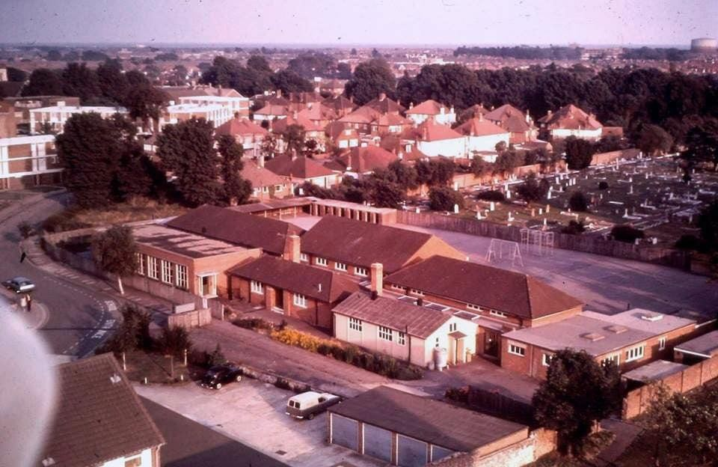
Frances Hodges
Building photo - Credit Terry Horner 1979/1980.

Slide 32
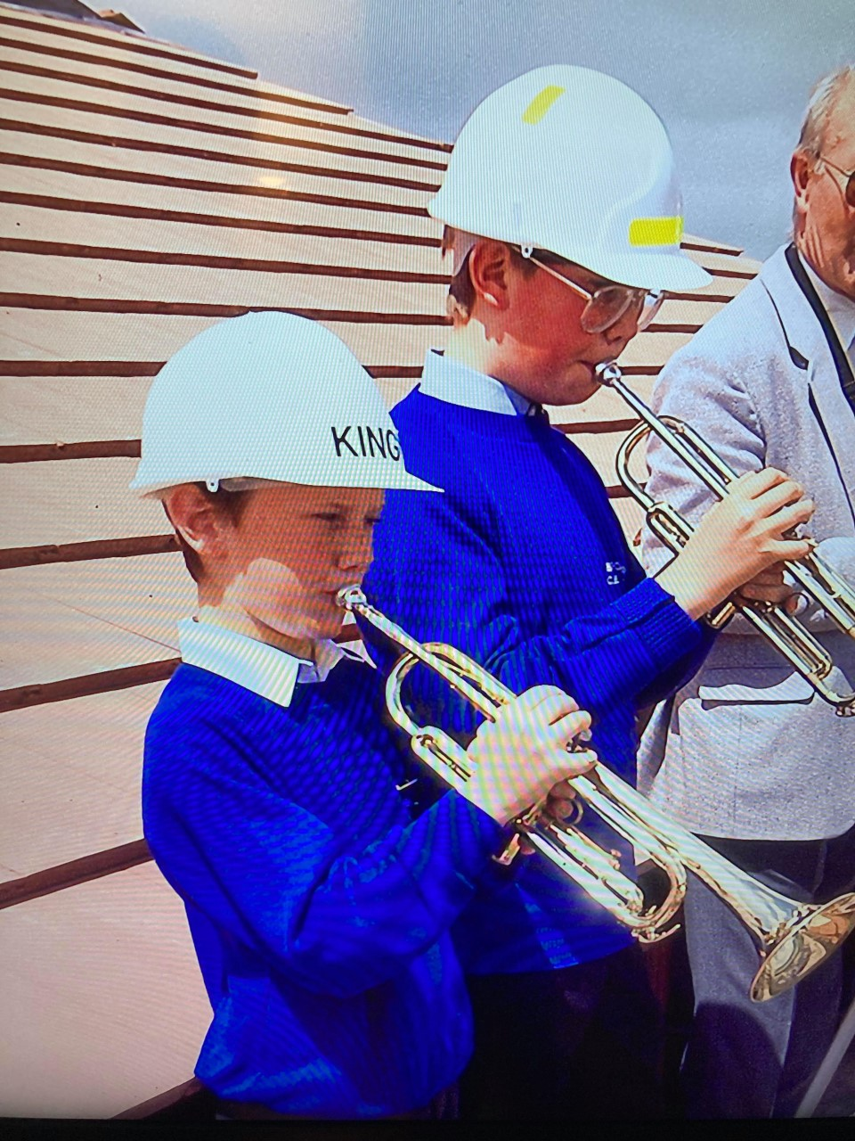
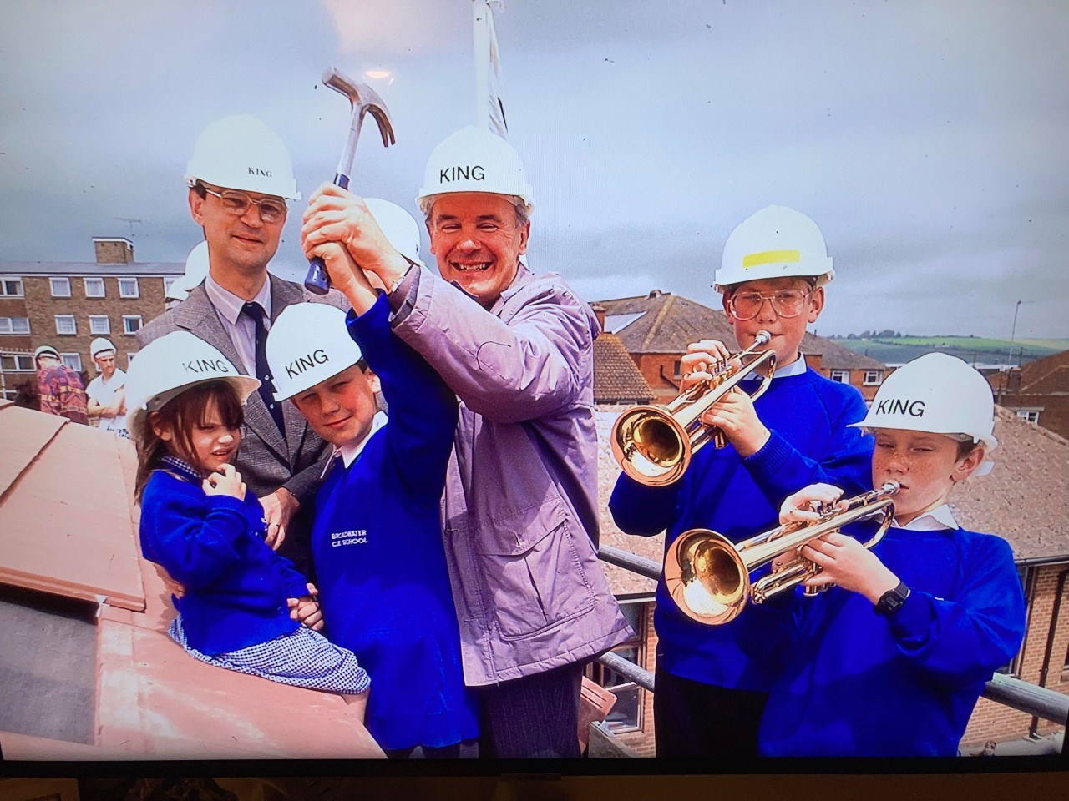
Frances Hodges
Phil Hodges (Dad of Jude Hodges - Swallow Class) was a past pupil of Broadwater C of E Primary and played his trumpet on the roof of the 'new' extension. Photo includes: L to R - Mr Hullett, Jamie Friend, Rev Dominie, Philip Hodges, Andrew Bleach - opening of the new school extension.

Slide 33
Rose Tucker
I went to Broadwater from 1996-2004 I think and remember whilst in year 7, trying to convince teachers to make it a high school too as I really didn’t want to leave! I have so many memories of every year I was at the school and always said I’d become a teacher and work there one day. My life plans have changed but the fondness I have for my time there hasn’t.
Here are some of my favourite memories - • My teachers. I remember them all but I was especially fond of Miss Tyrell (now Mrs Lawson) who I had in Reception and year 2, and Miss Barrows in year 1.
• Mr Collinge, part firefighter, part teacher, led the best assemblies with songs like ‘great, great, brill, brill’ and organised days where the field would become an extension of the fire station.
• Summer BBQs with hula hoop competitions. I taught myself to hoop one year specifically for this competition 😅
• One year a massive snake was found in/on the games shed, and to us children at the time that was the most dramatic thing ever! They had to close the field and the pond playground while the official snake people came to take it.
• Raising money for the millennium statue that was placed in the pond playground, back when there was a pond! Also the whole school millennium photo was pretty impressive when it was hung in the corridor. I remember being delighted that I was near the middle but annoyed that I was squinting in the sun 😂

Slide 34
Rose Tucker
• When the new PE climbing equipment was put in the school hall. I think it’s still there. It was bright and shiny and I remember thinking our school was so cool for having it. PE was a lot of fun!
• Doing a sponsored silence with a friend in year 7, and while tidying the PE cupboard at lunch time as part of our PE monitor duties, accidentally speaking, desperately trying not to giggle about it, then vowing never to speak of it again… 😬
• Winning an indoor sports competition. I think it was athletics. We were never one of the big schools that usually did really well at sports events and I remember it being such a proud moment for everyone. I still have the rosette.
• Starting netball in year 5. I’ve played ever since and now coach, including a couple of girls who go to the school now.
There are plenty more but I’ll stop there!
I still have all the certificates I was given while I was there, as well as the mug we were given for the Queen’s Jubilee and I think I still have my old PE shorts. I also still have all my topic books and some class photos. I’d happily bring them in to share if you’d like.
It has been lovely to reminisce!

Slide 35
Rose Tucker
We also buried a time capsule, I’m pretty sure it was in the millennium year. Couldn’t tell you where, but it was somewhere on the field I think. I wonder if that’s still there?

Slide 36
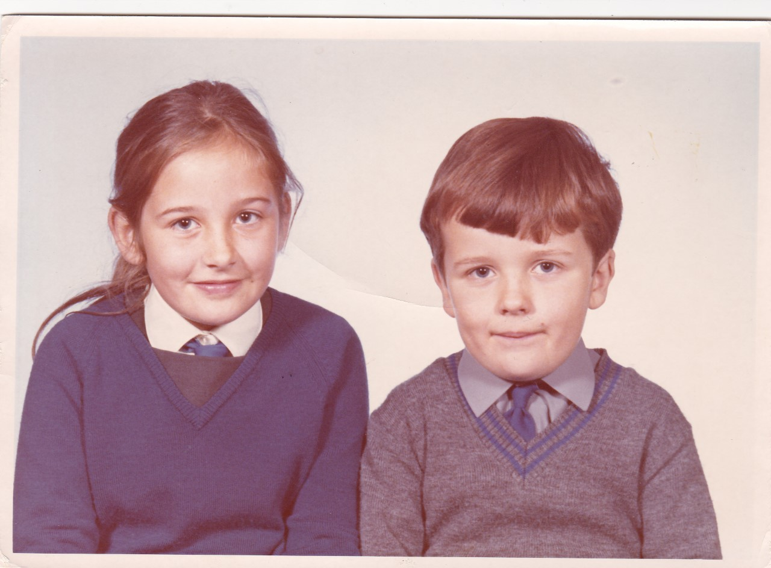
Jenny Fay
The first photo was taken when Gavin was in reception and I was in Year 4 (1969) and the second one when Gavin was in Year 3 and I was in Year 6 (1971). The other photos in the garden are of Gavin’s first day at school in 1969.

Slide 37
Jenny Fay
I attended Broadwater C. of E Primary School from September 1967 when I joined Year 2, having moved from South Lancing, until July 1972 when I then moved on to the girls grammar school, Worthing High School for Girls in South Farm Road and my year was the last year to take the 11 plus. Of the 40 children in my class, 6 of us went to Worthing High School for Girls, 1 to Worthing High School for boys and 3 to the Technical High School, which is now Durrington High School and the rest went to St Andrews and Davison Schools. My brother Gavin, attended the school from September 1969 until July 1976 – he joined in his reception year and in those days had to spend the equivalent of his Year 7 there too after West Sussex went comprehensive. He then moved on to St Andrews High School.

Slide 38
Jenny Fay
I have fond memories of Broadwater then – it was quite a small school – one year entry and 40 children in each class, which must have been hard work for the teacher, because we didn’t have LSAs in those days. We were so wedged in our seats, there was no hope of getting up and moving around once we had sat down ! ( I am a retired Science & Maths secondary school teacher so understand the pressures!) I also remember that from Year 3, we had to write in italics with a fountain pen, specifically with an italic medium straight nib. It was quite a religious school –daily assemblies with lots of hymn singing and traipsing down to Broadwater Church- I still have the Bible that each pupil was presented with as a gift.

Slide 39
Jenny Fay
In our time, Mr Tammadge was the Headmaster and was very strict – he had a cane in a glass cabinet outside his office, but don’t know if he ever used it! My teachers were Miss Norrish in Year 2, Miss Croudson in Years 3 and 5, who liked to play her guitar whilst we all sang along, Mr Paine in Year 4 ( he went off to be a missionary halfway through the school year) Miss Wilkes took over and taught the whole class to crochet blanket squares for the Vietnam War and Mr Mountifield in Year 6. I also remember Mrs Cass the Welfare Assistant.
I have recently moved back to Worthing after living in Walton on Thames for 30 years and am now living in my childhood home with my own family. I would be interested in any details of your 150 year celebration activities.

Slide 40
Sarah Searle
I was SENCO and First School class teacher at Broadwater in the 1990s alongside my 3 children who were pupils there from 1985 to 1996. It was a privilege to work with such a creative and talented staff team. It's hard to isolate particular events and people after almost 30 years but here's a few:
Team teaching with Andrew Morris in Year One - his mentorship, as I returned to teaching after a long break, was much appreciated and his passion for the centrality of the arts in primary education stayed with me throughout my career
The leadership of John Hulett who was committed to a child-centred curriculum and opportunities to shine for all pupils. In the early days of the integration policy, his understanding and support for the children with SEN was innovative and resolute
Great fun with Margaret Allen with whom I team-taught in Years 2 & 3 for a few years. I was meant to be mentoring her as she was newly qualified but learnt so much more from her than I could offer.

Slide 41
Sarah Searle
Leading a revamped "Hymn Practice' with Victoria Tilley and Rachel Charnick. Thursday afternoons were always fun - lots of singing in parts, spontaneous drama and games. Hope the children enjoyed themselves as much as we did.
Sitting under the shady Oak (?) tree on the field on hot summer days reading stories to the class before they went home - sometimes distracted by Fire Station activity
Apologies to those I haven't named and thanks from all the family for an outstanding Primary School experience. The children thrived with each one of their teachers in different ways and we all have fond memories of those Broadwater days. Thank You!

Slide 42
Ruth Covey
I and my three siblings attended this school from around 1959 till late sixties. I have come across a few photos of my youngest brother and a group photo with I believe Mr Fisher, headmaster at the time standing behind a group of children eating lunch in the school grounds.
The teachers who were there when I was there were Mrs Gibson Poole, Miss Rudd, Miss Toone, Mr Farley and Mr Hanford. I know the deadline for information given in article was 26th April.

Slide 43
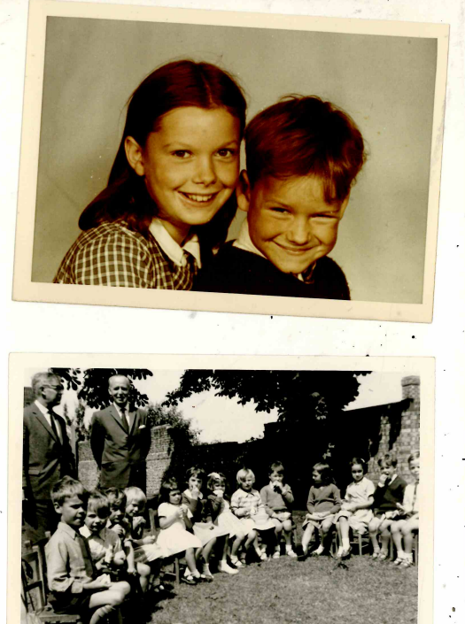
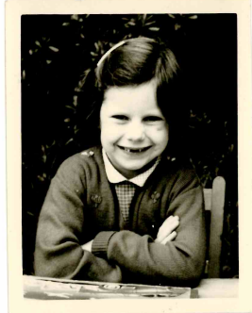
Ruth Covey

Slide 44
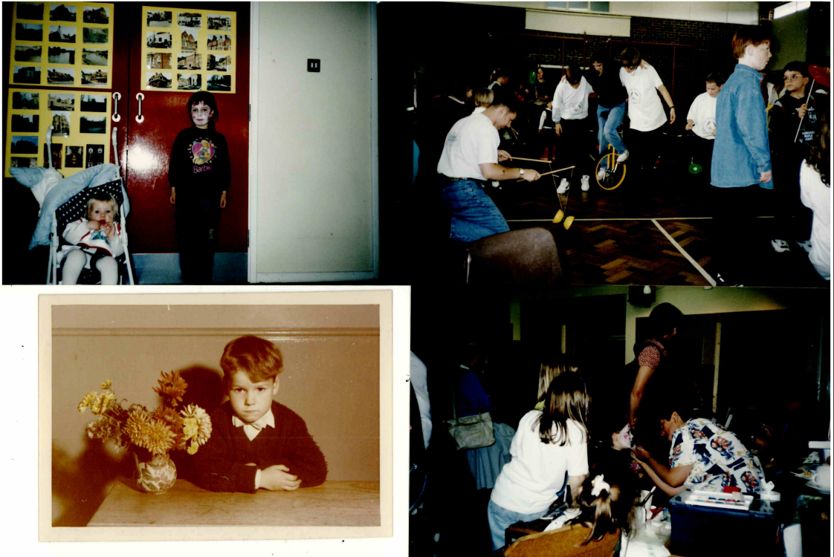
Ruth Covey

Slide 45
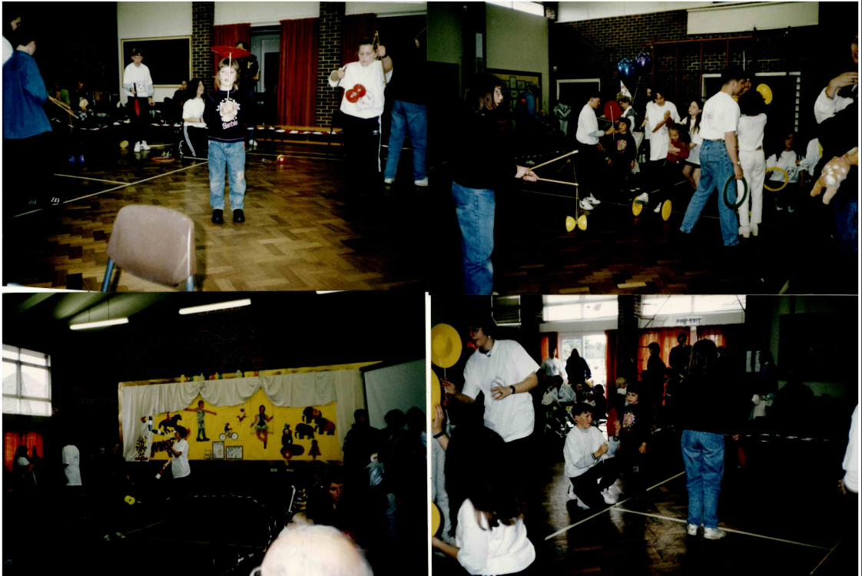
Ruth Covey

Slide 46
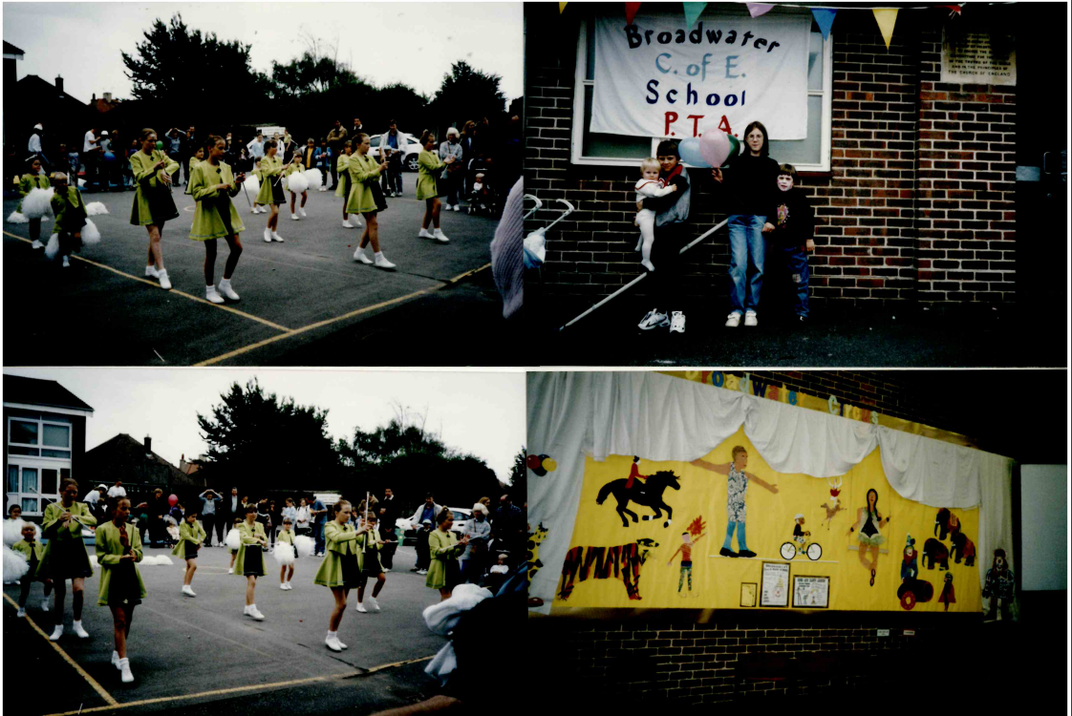
Ruth Covey

Slide 47
Janet Bath
I was student at the school for three years in the late 1950s having moved to the area from Bognor Regis.
Following are memories of my time at Broadwater:
For some reason I, and a few others, were put into Mr. Hansford’s class part way through a summer term. The class had already paid for a school trip to Hampton Court Palace, but one classmate had had to drop out, and I was fortunate enough to win the draw to take his place.
Mr. Hansford’s general knowledge and mental math quizzes. Loved the former, hated the latter!
The girls’ toilets which were just outside the main building and which, to me, were always dank, dark and to be avoided as much as possible!
Deciding, with a friend, to stay for school lunch at some point during the term so that we had more time to play sports. Initially, we were added to a table of younger children who ate slowly which meant we did not achieve our goal. We asked to be moved, and ended up at separate tables with older boys who would only accept us if we ate quickly so they could get out to play soccer. I have been a fast eater ever since!

Slide 48
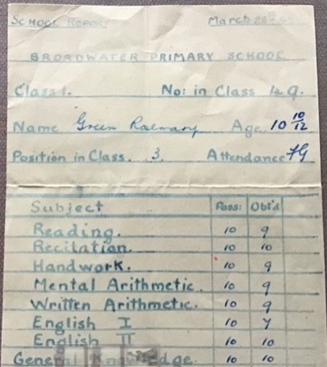
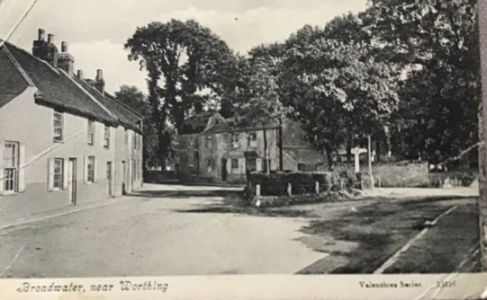
Rosemary Russell

Slide 49
Jez Wong – former headteacher

